Slide 1
Watershed Health Indicators
By: Azarius Karanja
WSCSD Kenya
Adopt- A- River Project T.o.t Training, 7th July 2015, Nairobi.

Slide 2
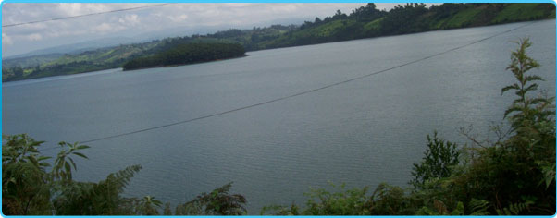
A wetlands in Kenya.

Slide 3
Measures of Stream Health
Physical indicators | Chemical indicators | Biological indicators
Bank erosion and stability | Water conductivity | Type and structure bank and aquatic vegetation
Nature of bottom substrate | Water pH | Algae growth and concentration
Water Colour, smell and clarity | Dissolved oxygen | Chlorophyll a and diatoms
Water flow rate | Total dissolved solids | Faecal coliform
Water turbidity | Total phosphorus | Aquatic insects and other invertebrates
Water temperature | Reactive phosphate
 | Total nitrate | Functional structure of communities of fish, amphibians, reptiles, birds and mammals

Slide 4
Physical Parameters
Water colour, odour
Water flow rate
Water temperature
Water turbidity
Nature of bottom substrate
Nature of the stream channel –bank erosion and stability

Slide 5
Chemical Parameters
pH
Dissolved Oxygen
Conductivity
Total Dissolved Solids
Total phosphorus
Reactive phosphate
Total nitrate

Slide 6
Biological Parameters
Type and structure of bank and aquatic vegetation
Algae growth and concentration
Chlorophyll a and diatoms
Faecal coliform
Aquatic insects and other invertebrates
Functional structure of communities of fish, amphibians, reptiles, birds and mammals

Slide 7
Bio - Monitoring
Biological monitoring of wetlands health is based on the principle that incidence and intensity of environmental stressors is a function of the degree to which the chosen endpoint organism association deviates from its expected natural diversity.

Slide 8
Rationale for Bio-Monitoring
Biotic communities are affected by a multitude of chemical and physical influences the condition of the aquatic biota thus reflects the overall condition of a river ecosystem

Slide 9
Systems of Bio monitoring
River Invertebrate Prediction and Classification System (RIVPACS).
The RIVPACS and its derivative AusRivAS (Australian River Assessment Systems) are statistical models that predict the expected presence of aquatic macro invertebrate fauna at sites that have no environmental stressors.

Slide 10
These models have the advantage of having a high turnaround of results hence there use in rapid bio-assessment programs and they are easy to understand and apply by natural resources managers

Slide 11
The South African Scoring Index (SASS) Version 5 – SASS.5
The (SASS) is a rapid bioassessment method for rivers developed over several iterations of refinement (Chutter 1994, 1998).This technique is the standard for the rapid bioassessment of rivers in South Africa and now forms the backbone of its National River Health Programme (Uys et al., 1996).

Slide 12
The method is designed for low/moderate flow and works best when the diversity of biotopes is and includes riffles or rapids. It has been asserted by Denis and Graham, (2002) that SASS.5 produces valuable results from poor habitats.

Slide 13
A comparison of the samples predicted to occur at test sites and those actually collected provides a measure of biological impairment at the test sites.

Slide 14
Why Macro Invertebrates?
Being ubiquitous, they are affected by perturbations in all types of waters and habitats
Large numbers of species offer a spectrum of responses to perturbations
The sedentary nature of many species allows spatial analysis of disturbance effects

Slide 15
Their long life cycles allow effects of regular or intermittent perturbations, variable concentrations, etc., to be examined temporally
Responses of many common species to different types of pollution have been established
Macroinvertebrates are well suited to experimental studies of perturbation

Slide 16
Qualitative sampling and analysis are well developed, and can be done using simple, inexpensive equipment
Taxonomy of many groups is well known and identification keys are available
Many methods of data analysis have been developed for macroinvertebrate assemblages

Slide 17
Normally benthic (river-bed) dwelling invertebrates
Insects, worms, molluscs and crustaceans (on the riverbed or channel margins)
Play important role in river functioning (retaining and breaking down of organics)
Useful for river characterization and monitoring
Small and relatively immobile, makes for easy collection

