Slide 1



GREEN GROWTH AND CIRCULAR ECONOMY
PATRICIA MUMBI WAMBUA
PRINCIPAL ENVIRONMENTAL EDUCATION & AWARENESS OFFICER
NEMA –KENYA HEADQUARTERS -NAIROBI

Slide 2
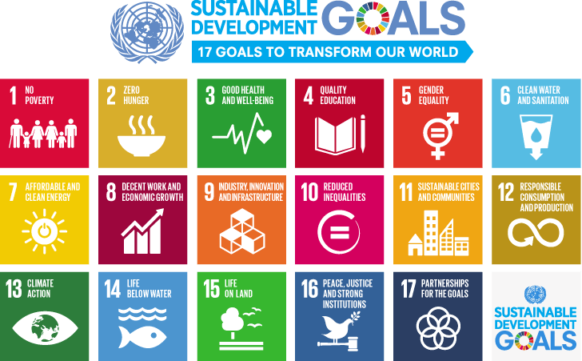
Worldview of Sustainability and Inclusiveness: the SDGs

Slide 3
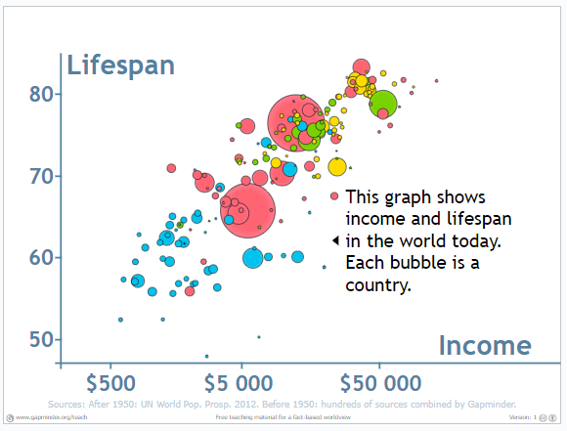
Global Income and life Expectancy
3
8/28/2023
Notes:
3

Slide 4
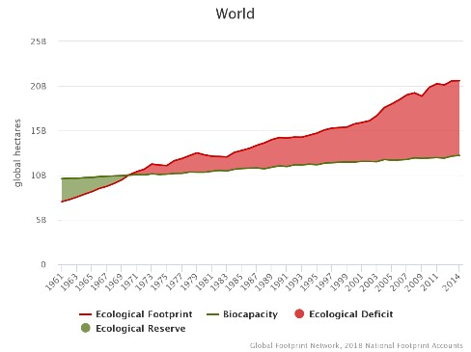
Ecological footprint (Demand) and biocapacity (Supply)
Ecological Footprint = pressure on local biocapacity. It’s a measure of how fast we consume resources and generate waste compared to how fast nature can regenerate (absorb our waste and generate resources)
Ecological Deficit since 1970s
Trends in global Ecological Footprint and biocapacity tell us that the human economy requires more biocapacity each year, indicating unsustainable rates of global consumption since 1970s
4
8/28/2023
Notes:
4

Slide 5
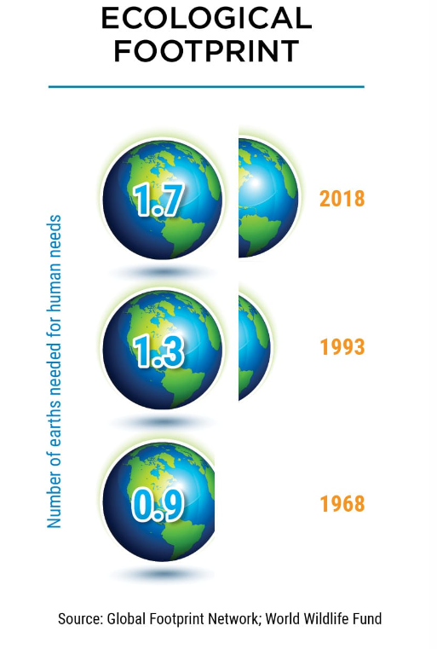
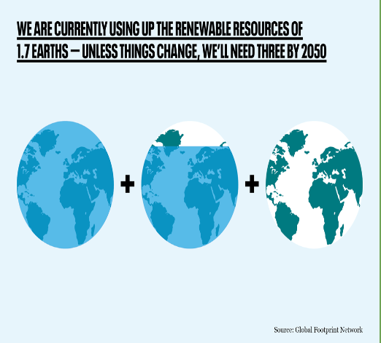
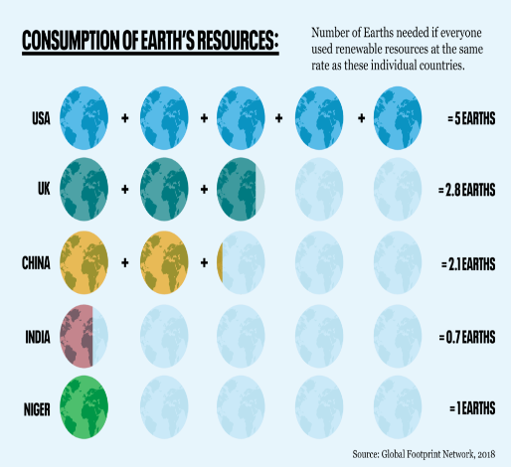
Ecological footprint (Demand) and biocapacity (Supply)
5
8/28/2023
Notes:
5

Slide 6
The planetary boundaries concept
This is a set of nine planetary boundaries within which humanity can continue to develop and thrive for generations to come
Crossing these boundaries increases the risk of generating large-scale abrupt or irreversible environmental changes.
In 2015 estimated that society’s activities have pushed climate change, biodiversity loss, shifts in nutrient cycles (nitrogen and phosphorus), and land use beyond the boundaries into unprecedented territory.
In 2022: humanity exceeded a planetary boundary related to environmental pollutants and other “novel entities” including plastics.
6
8/28/2023
Notes:
6
The chemical pollution boundary has been expanded and renamed “novel entities” created entirely by us humans. They include emissions of toxic compounds such as synthetic organic pollutants and radioactive materials, but also genetically modified organisms, nanomaterials, and micro-plastics

Slide 7
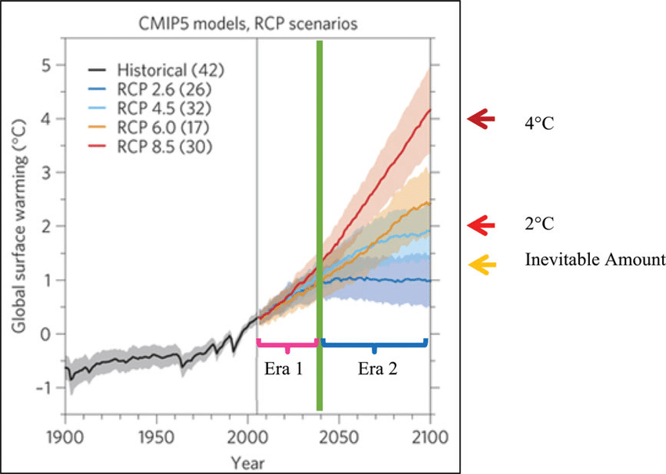
CLIMATE EMERGENCY
Representative Concentration Pathway (RCP) is a greenhouse gas concentration trajectory - IPCC
RCP 2.6 is a "very stringent" pathway where CO₂ emissions start declining by 2020 and go to zero by 2100 to keep global temperature rise below 2 °C by 2100
RCP 4.5 intermediate scenario: Emissions to peak around 2040 then decline: global temperature rise between 2 °C - 3 °C, by 2100 with a mean sea level rise 35% higher than that of RCP 2.6. Many plant and animal species will be unable to adapt to the effects
RCP 6, emissions peak around 2080, then decline continuous global warming through 2100 where CO2 levels rise to 670 ppm temp rise by about 3–4 °C by 2100
RCP 8.5 emissions continue to rise throughout the 21st century 3-4.8 °C by 2100
7
8/28/2023
Notes:
7
The Intergovernmental Panel on Climate Change (IPCC) is an intergovernmental body of the United Nations. Its job is to advance scientific knowledge about climate change caused by human activities

Slide 8
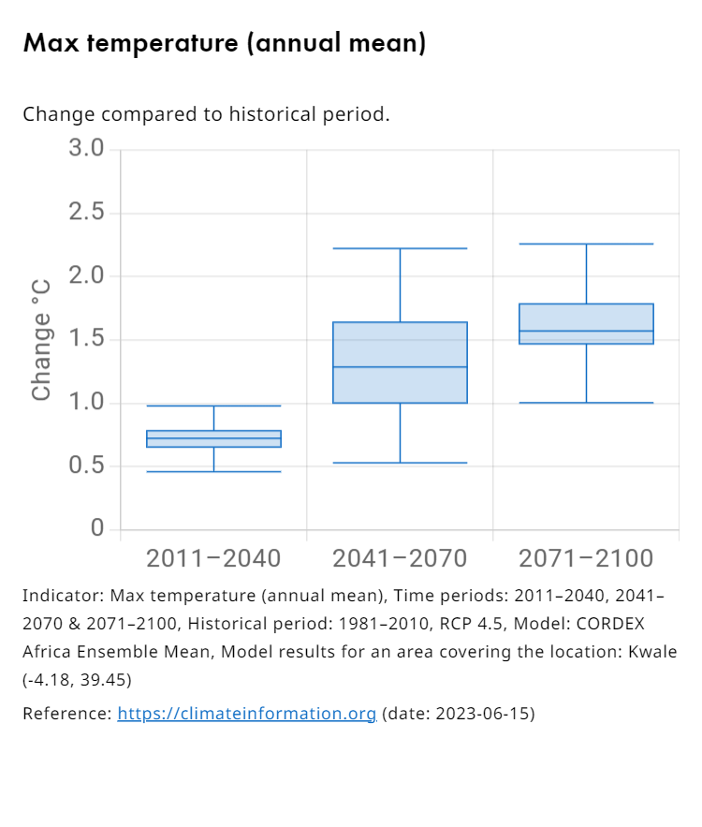
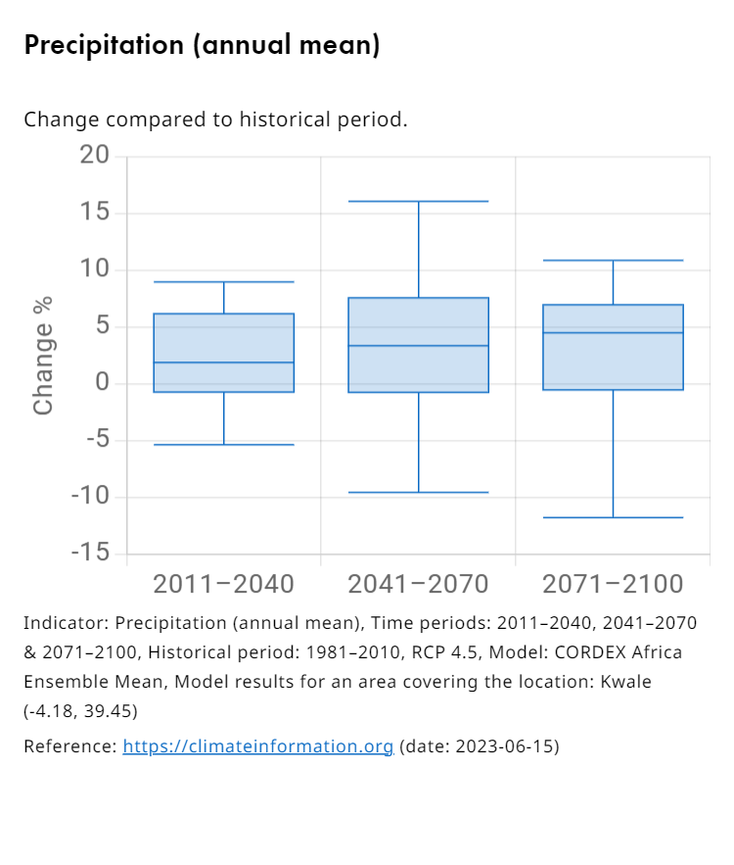

Slide 9
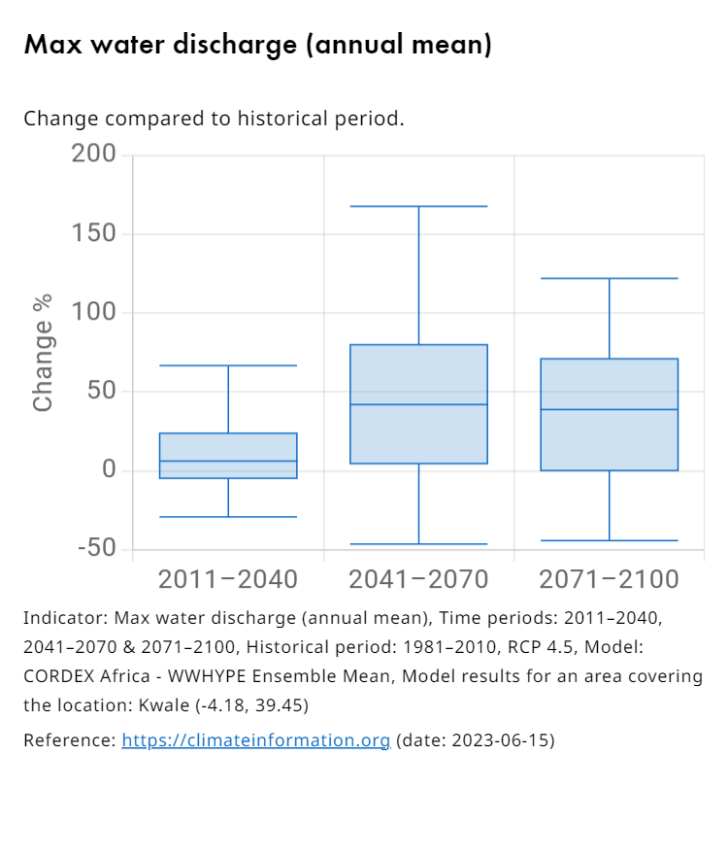

Slide 10
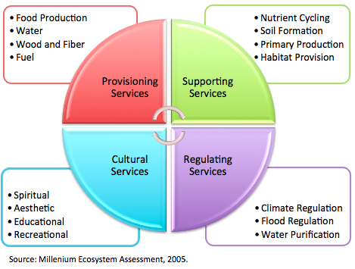
ECOSYSTEM SERVICES
To derive benefits from ecosystems, we must re-think and be purposeful towards sustainability
We cannot continue with business as usual
10
8/28/2023
Notes:
10

Slide 11
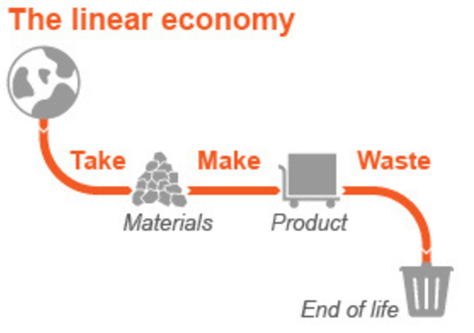
Linear economy

Slide 12
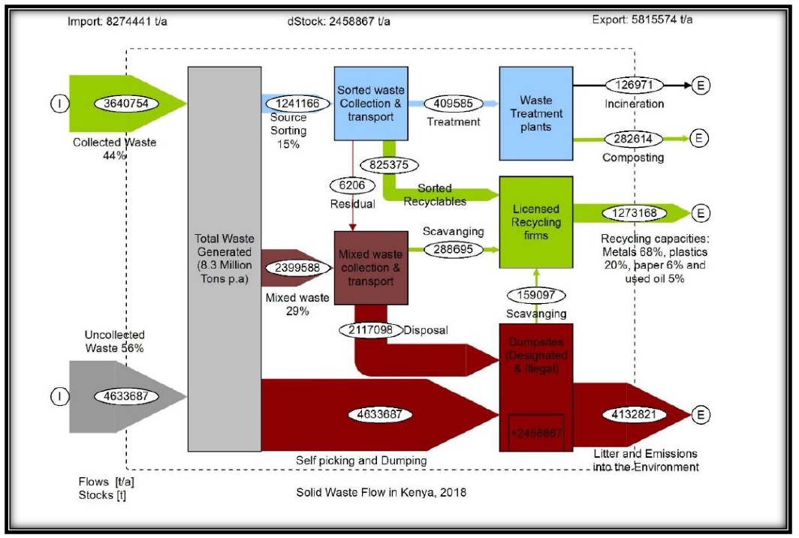
Linear economy: Waste management scenario in Kenya

Slide 13
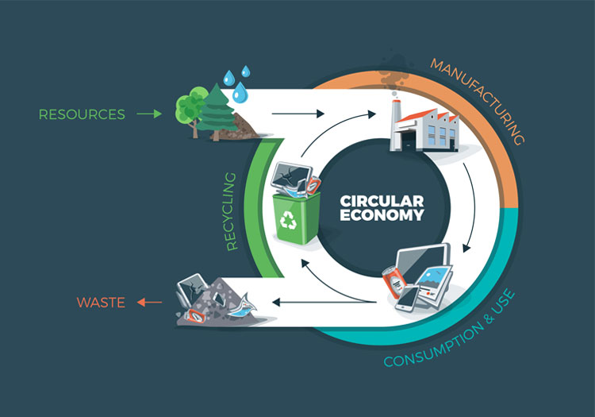
Circular Economy

Slide 14
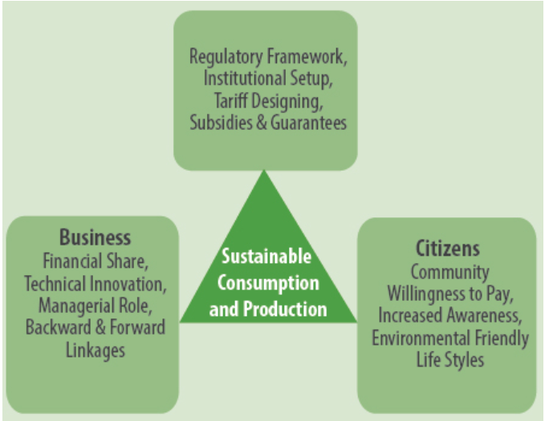
Green Economy
A green economy is a low carbon, resource efficient and socially inclusive, (UNEP).
In a green economy, growth in employment and income are driven by public and private investment into such economic activities, infrastructure and assets that allow:
Reduced carbon emissions and pollution,
Enhanced energy and resource efficiency,
Prevention of the loss of biodiversity and ecosystem services

Slide 15
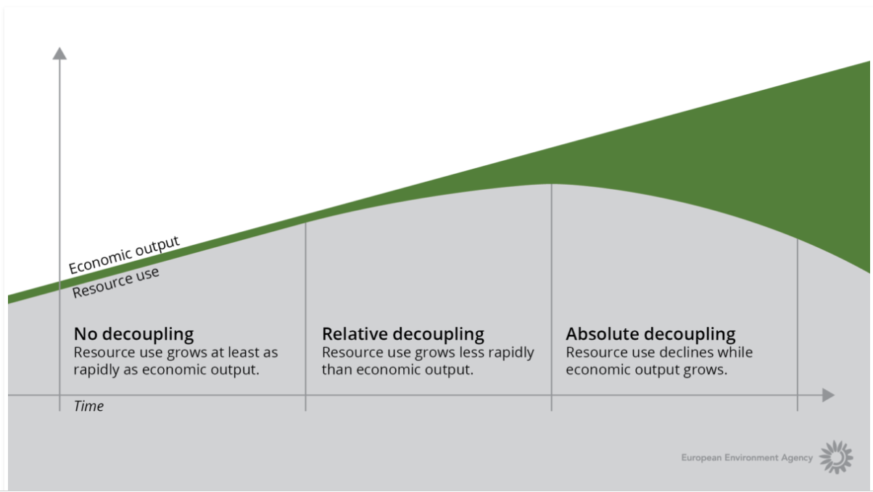
Green Economy
Green Growth economic models seek to decouple economic growth from resource consumption and/or environmental impacts
Linear Phase
Transitional Phase
Circular Phase

Slide 16
Green and Circular Economy and role of CEC
Green Procurement?
How can CEC facilitate green growth and circular economy in the County?
How can Municipalities align themselves as centers of green growth and CE?

Slide 17

Discussion on role of CEC in Green and Circular Economy

Slide 18


www.nema.go.ke
Vision
A clean, healthy and sustainable environment
Mission
To coordinate, supervise and manage all matters relating to the environment in Kenya
Motto
Our Environment, Our life, Our Responsibility
THANK-YOU

Slide 19






www.nema.go.ke
dgnema@nema.go.ke
@NemaKenya
National Environment Management Authority-Kenya
NEMA Kenya
NEMA Kenya

